Slide 1

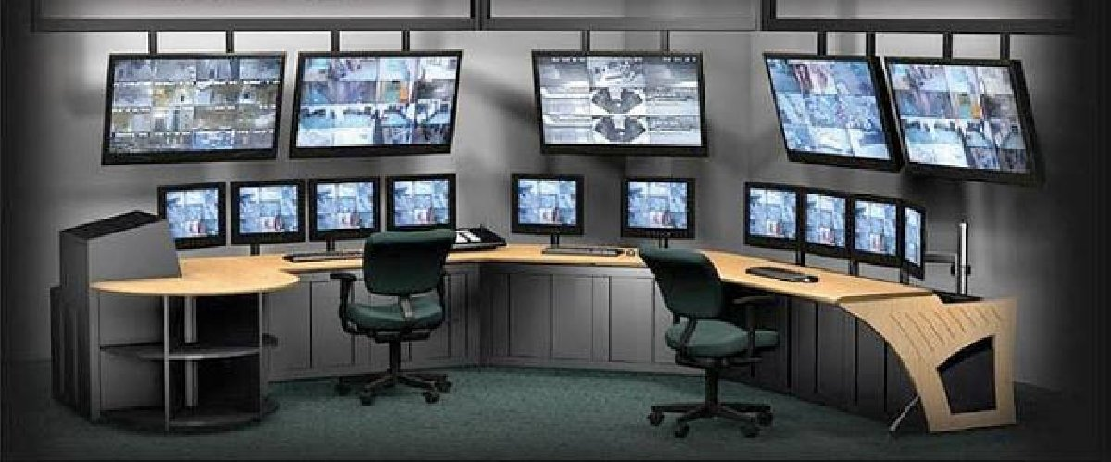



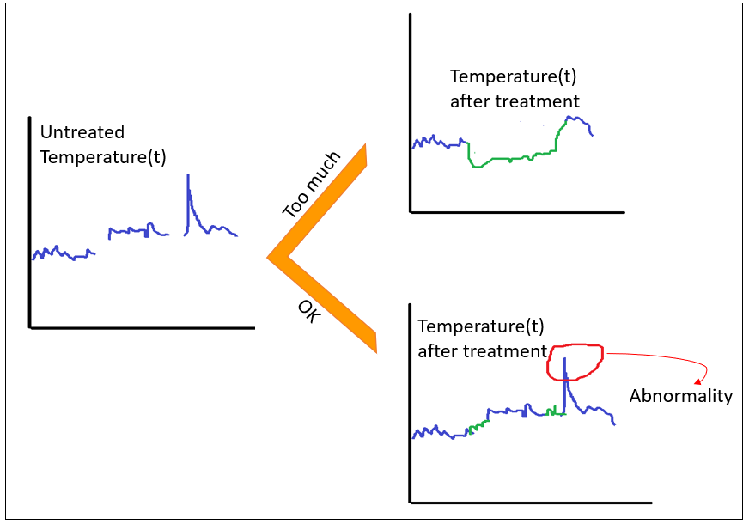

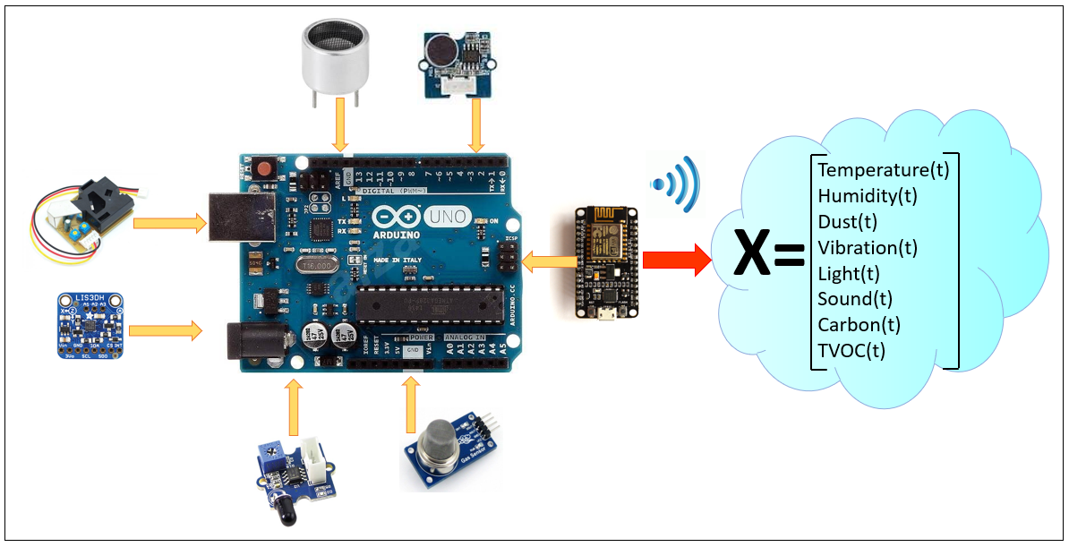

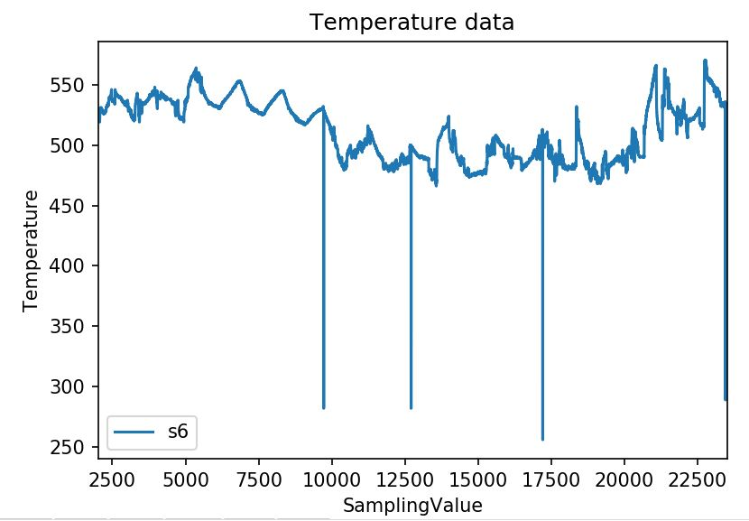
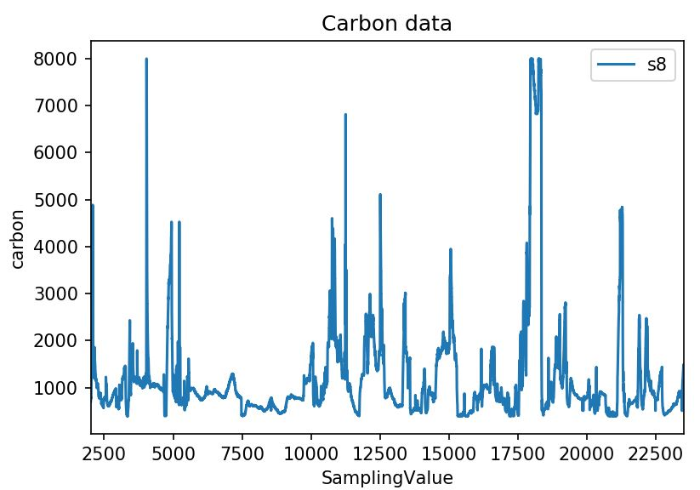
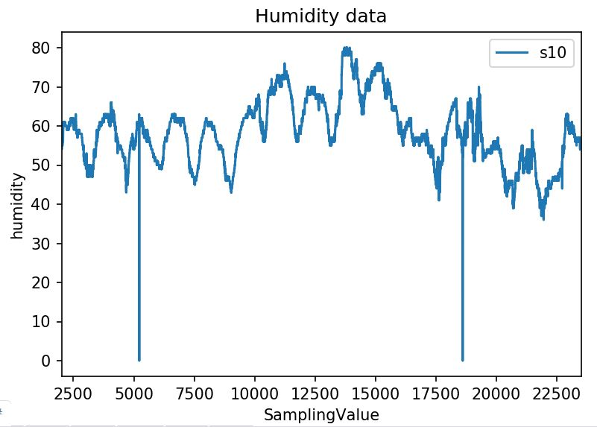
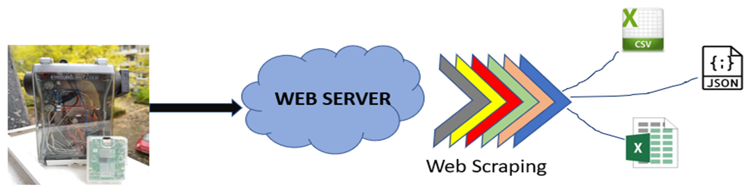
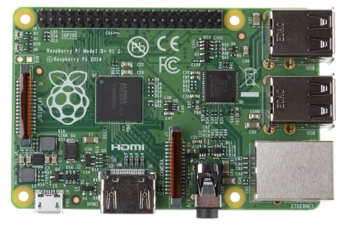
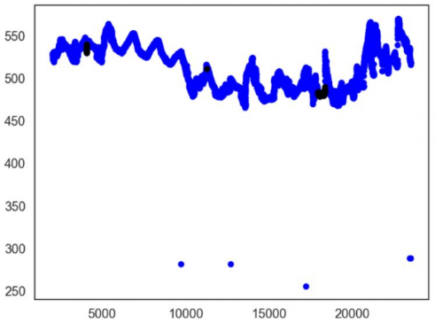
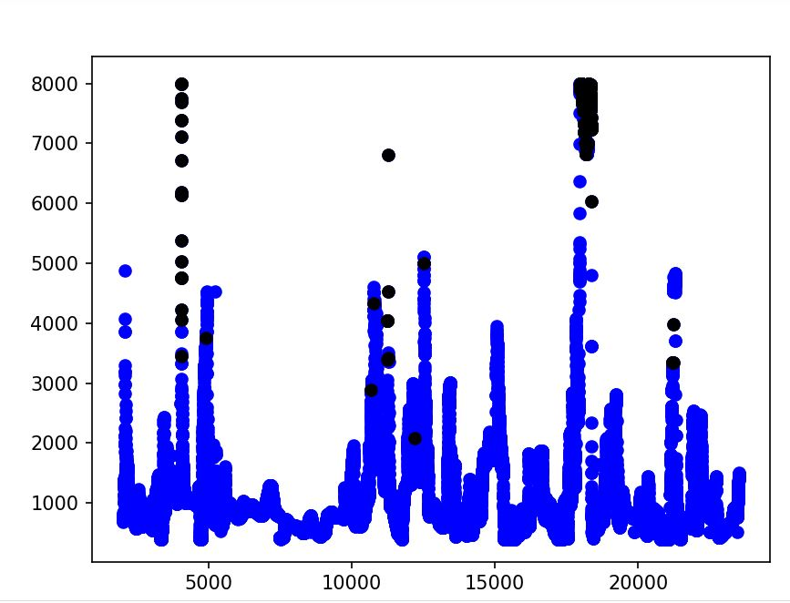
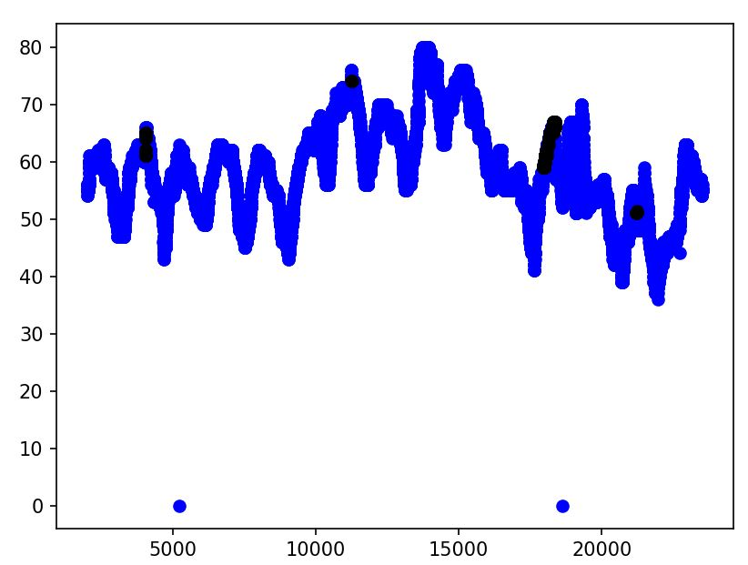
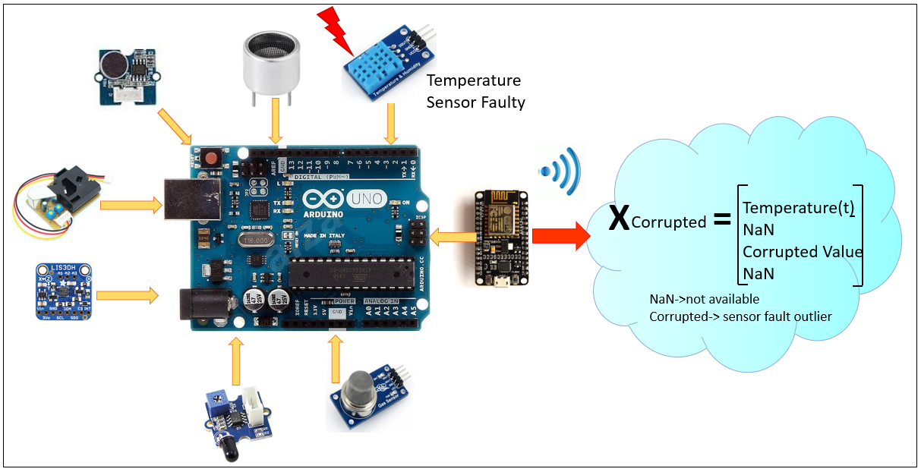
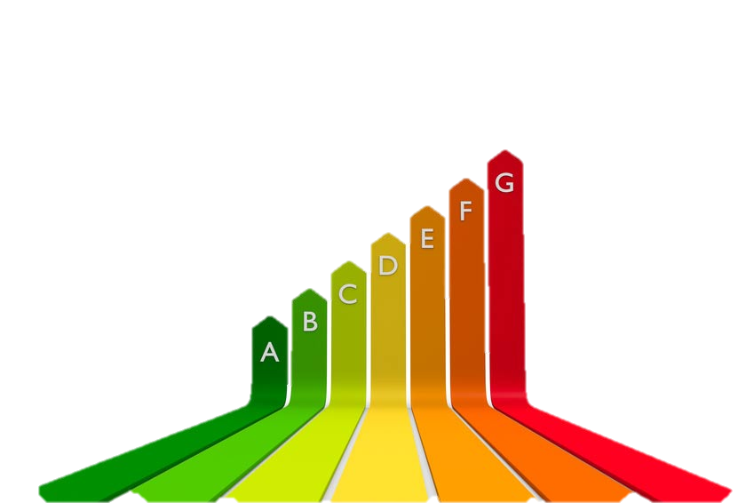
Anomaly Detection using Unsupervised Learning
Shantanu Dave
As we are moving towards the Industry 4.0 era Artificial Intelligence and the Internet of Things are becoming crucial and integral parts of the revolution. The objective is to develop an online multivariate analysis tool using Unsupervised Learning for abnormality detection in plants helping to detect critical situations as soon as possible and by that reducing costs and increasing productivity, availability and reliability.
Fault
past
Field visit
present
future scenario
Risks in present age
Limitations of Data Pre-processing
The field visit does not occur as per schedule. For Instance, new employees or no time for the visit due to involvement in some other tasks (e.g. sample taking).
The fault occurs outside the area of the standard plant/field visit timings.
The failure can not be detected with the existing measuring technology (or at least not promptly).
Measurement technology detects and alerts the fault, but is lost in the surge of other alarms.
Task Description-Development of Intelligence
Experimental Setup
Fetch data from an Access Point (Sensor Bot)
Impute missing data, eliminate outliers and non compliant data.
Perform the Unsupervised Learning and inform the user in case of any out of control situation (abnormality) is detected.
Routine
Sensor Bot
Breaking Routine
Can we detect abnormal situations with state of the art approaches for outlier detection that do not fit to the routine?
?
?
?
Time Series Data of some Sensors
Data Fetching
Data Extraction using web scraping technique
Use of Beautiful Soup module along with Requests in Python
Results (Unsupervised Learning)
Raspberry Pi
Undetected Outliers
Data Pre-processing
Undetected Outliers
Undetected Outliers
Conclusion
In our case, Classical approaches for Outliers/ Abnormal situation detection did not identify the out of control situations in Experimental setup.
Need for further work: upgrade of Bot with robust sensors and identification of modern algorithms which can detect abnormalities in producing plants or develop new theoretical approaches like “daily pattern prediction”
Laboratory for Automation Technology and Energy Management
Prof. Dr.-Ing. Markus Stockmann
Institute of Automation Engineering
Markus.Stockmann@th-koeln.de
Contact: Shantanu Dave
shantanu.dave@smail.th-koeln.de
Cologne University of Applied Sciences
(TH Köln)

